Slide 1
KANAK PTRINT-N-PACK Website (Packaging and Printing)
SHREYA MEHTA-53003150054

Slide 2
Overview
This website is very helpful for customers , retailers to view the packaging materials .
It also allows customize printing , based on the customer requirement and quotation.
Based on the state-of-the-art designing and manufacturing facilities, it provide a huge assortment of qualitative and exclusive range of packaging material that is catering to the requirements of diverse industries across the globe.
Flexible and versatile packaging material is reckoned for their outstanding features like rigid packaging, brilliant designs and prints, excellent clarity and impact strength.

Slide 3
Backed by proficient experts, and state-of-the-art, technologically advanced equipment, it make use of latest screen and offset printing technology in order to provide customized printing services to make the package more appealing along with promoting the concerned product and company.
Comprehending the importance of hygiene and safety factor in the packaging of certain goods, make use of non-toxic PVC material and perform intensive research to develop innovative and enduring packaging products.
It helps not only to beautify but ensure safety of customer products so that they arrive in the customers hand in mint condition.

Slide 4
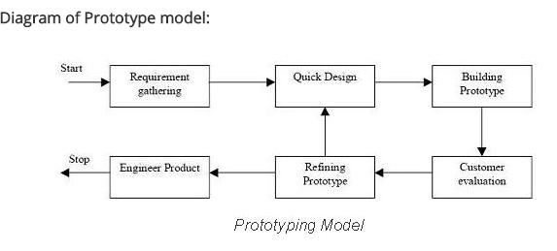
Model USED

Slide 5


